Slide 1
The Hitchhiker's Guide to the Webpack
Sara Vieira

Slide 2



Sara Vieira
@NikkitaFTW
github.com/SaraVieira

Slide 3


Eurovision
Portuguese League

Slide 4

Webpack

Slide 5
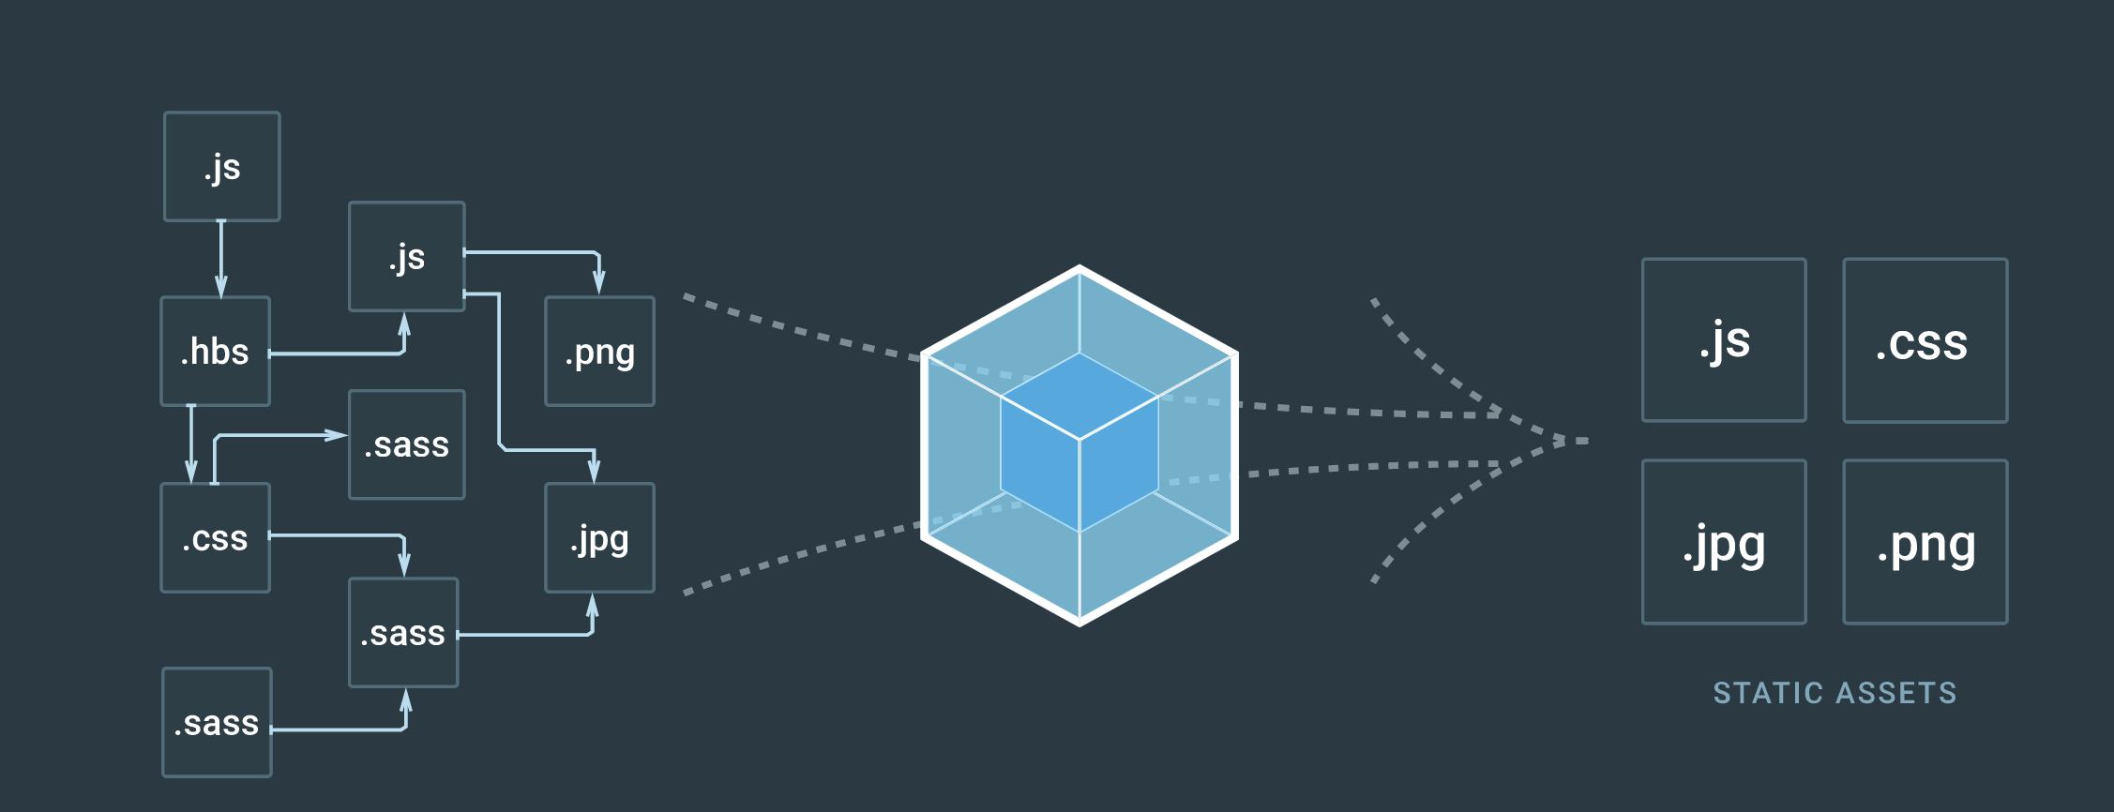

Slide 6
Project
React
Eslint
ES6
CSS Modules
PostCSS
Lots of linting

Slide 7
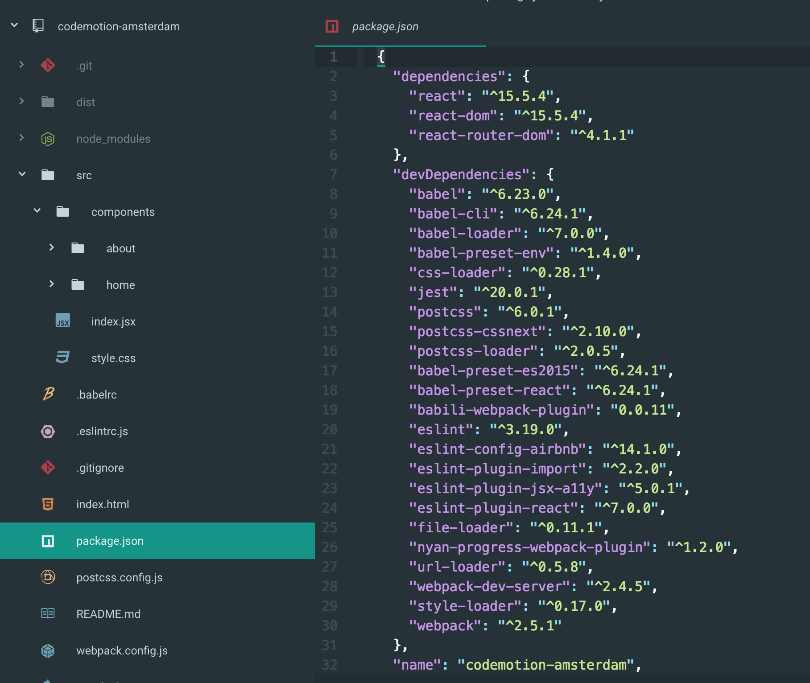
Folder
Structure
React
Images
Babel
CSS Modules
PostCSS

Slide 8
Install
Webpack
yarn add webpack --dev

Slide 9
Create
webpack.config.js
module.exports = {
}

Slide 10
Entry
File
module.exports = {
entry: './src/index.jsx',
}

Slide 11
Output
const path = require('path');
module.exports = {
entry: './src/index.jsx',
output: {
filename: 'bundle.js',
path: path.resolve(
__dirname, 'dist'
),
},
}

Slide 12
Resolve
Files
const path = require('path');
module.exports = {
entry: './src/index.jsx',
output: {
filename: 'bundle.js',
path: path.resolve(
__dirname, 'dist'
),
},
resolve: {
extensions: [
'.js',
'.jsx',
'.css
],
}
}

Slide 13
Module
Rules
const path = require('path');
module.exports = {
entry: './src/index.jsx',
output: {
filename: 'bundle.js',
path: path.resolve(
__dirname, 'dist'
),
},
resolve: {
extensions: ['.js', '.jsx'],
}
module: {
rules: [
]
}
}

Slide 14
Parse
Javascript
yarn add babel babel-core
babel-loader --dev
module: {
rules: [
{
test: /\.jsx?$/,
loader: 'babel-loader',
}
]
}

Slide 15
Set Up
Babel
yarn add babel-preset-env
babel-preset-react --dev
> .babelrc
{
"presets": [
["env", {
"modules": false,
"targets": {
"node": "current",
"browsers": [
"last 3 versions",
"last 4 iOS versions"
]
}
}],
"react"
]}

Slide 16
Parse
Images
yarn add url-loader --dev
module: {
rules: [
{
test: /\.jsx?$/,
loader: 'babel-loader',
},
{
test: /\.(jpg|png|svg)$/,
loader: 'url-loader',
options: {
limit: 10000,
},
},
]
}

Slide 17
Parse
CSS
yarn add style-loader
css-loader
postcss-loader
postcss --dev

Slide 18
Parse
CSS
{
test: /\.css$/,
use: [
'style-loader',
{
loader: 'css-loader',
options: {
modules: true,
camelCase: true,
sourceMaps: true,
localIdentName:
'[local]-[hash:base64:5]'
},
},
'postcss-loader',
],
},
]
}

Slide 19
Set Up
cssnext
yarn add postcss-cssnext --dev
> postcss.config.js
const cssnext =
require('postcss-cssnext')();
module.exports = () => ({
plugins: [cssnext],
});

Slide 20
Set up
Dev Server
yarn add
webpack-dev-server --dev
> webpack.config.js
devServer: {
port: 3000,
hot: true,
historyApiFallback: true,
},
> Terminal
webpack-dev-server
--hot --inline
--output-public-path=/dist/

Slide 21
Minifying
Javascript
yarn add
babili-webpack-plugin --dev
> webpack.config.js
const BabiliPlugin = require(
'babili-webpack-plugin');
plugins: [
new BabiliPlugin()
],

Slide 22
Add Awesomeness to the Terminal
yarn add
nyan-progress-webpack-plugin
--dev
> webpack.config.js
const NyanProgressPlugin =
require('
nyan-progress-webpack-plugin
');
plugins: [
new BabiliPlugin(),
new NyanProgressPlugin(),
],

Slide 23
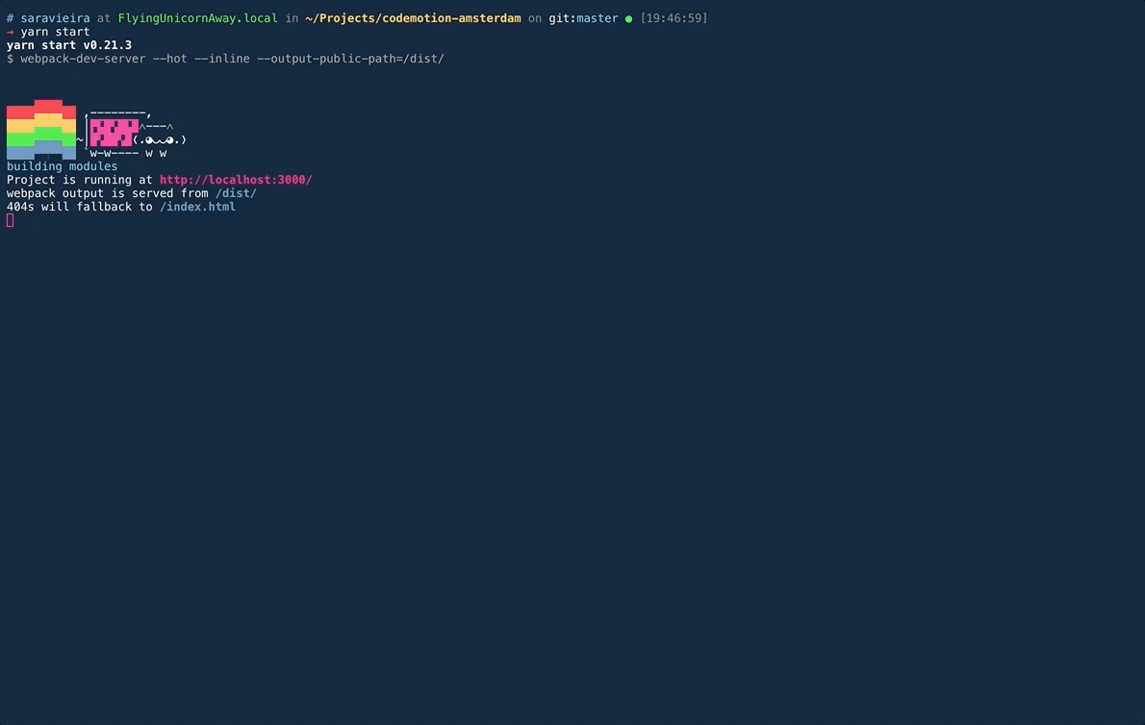

Slide 24
Webpack CLI
yarn global add webpack-cli
webpack-cli init

Slide 25

ALL THE
LINTING

Slide 26
Lint the
Javascript
yarn add
eslint
eslint-config-airbnb
eslint-plugin-react
eslint-plugin-prettier
eslint-plugin-import
eslint-plugin-jsx-a11y --dev

Slide 27
Lint the
Javascript
> .eslintrc.js
module.exports = {
"env": {
"browser": true
},
"extends": "airbnb",
"plugins": [
"react",
“impiort",
"prepttier",
"jsx-a11y"
]
};

Slide 28
Lint the
CSS
yarn add stylelint
stylelint-config-standard
stylefmt --dev
> .stylelintrc
{
"extends":
"stylelint-config-standard"
}

Slide 29

Awesome
Tools

Slide 30
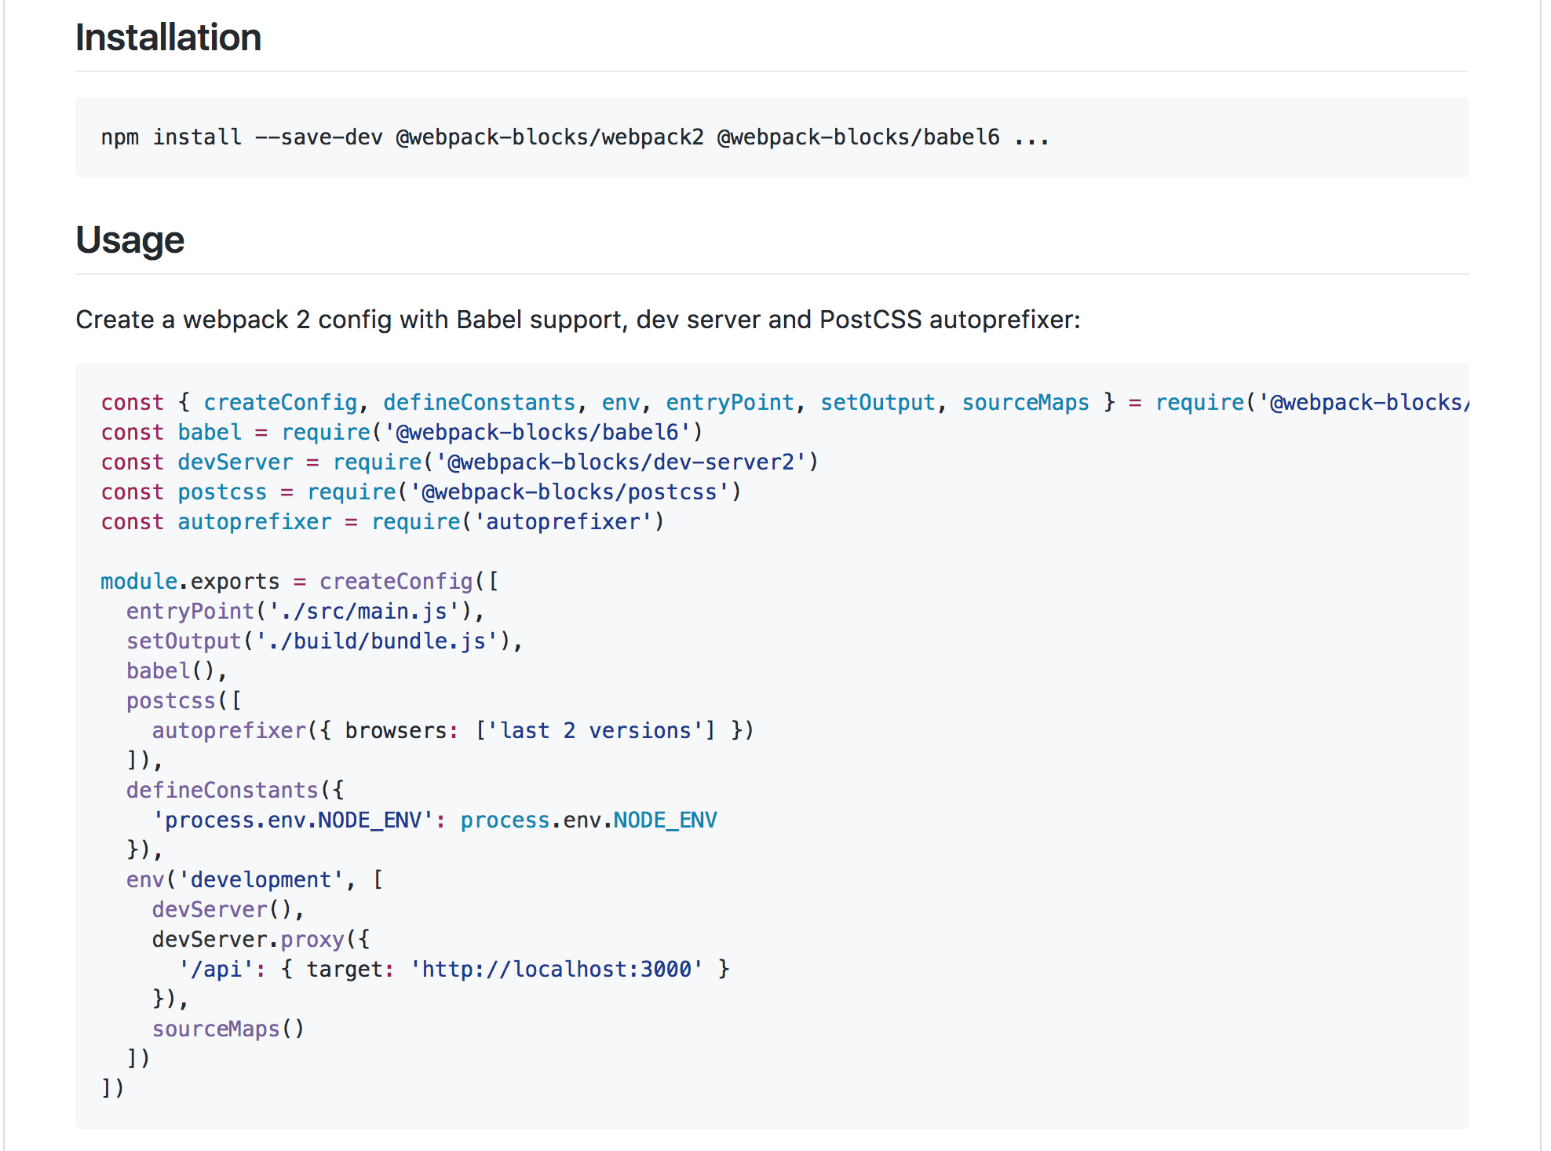
Webpack
Blocks
yarn global add webpack-cli
webpack-cli init
Functional building blocks for the webpack config.

Slide 31
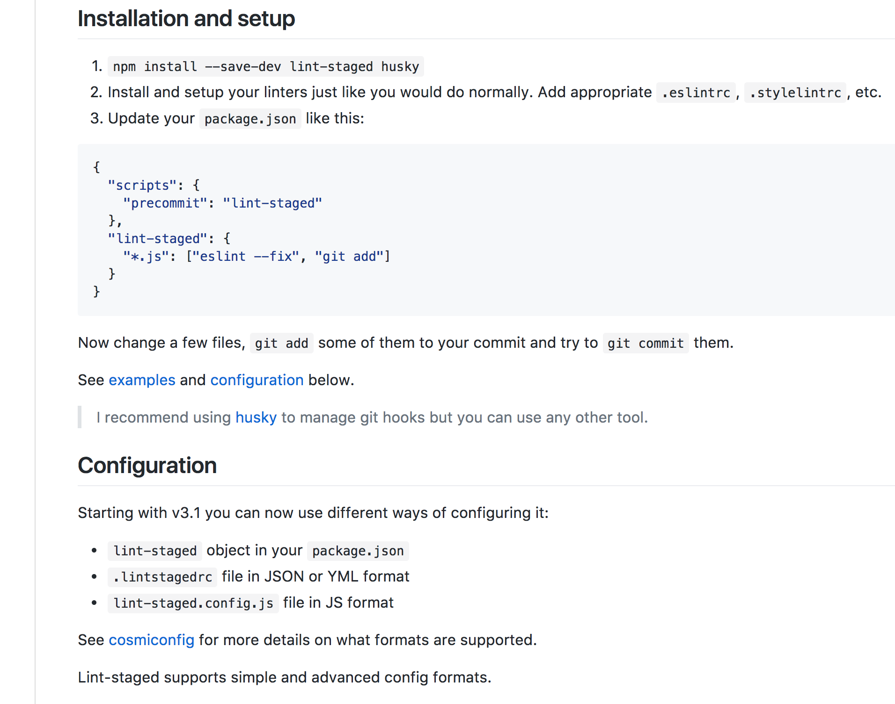
Lint
Staged
yarn global add webpack-cli
webpack-cli init
Run linters on git staged files

Slide 32

Thank You
github.com/SaraVieira/codemotion-amsterdam

